Slide 1

Discovering riendships
Drew Wicke
Mike Sharov

Slide 2
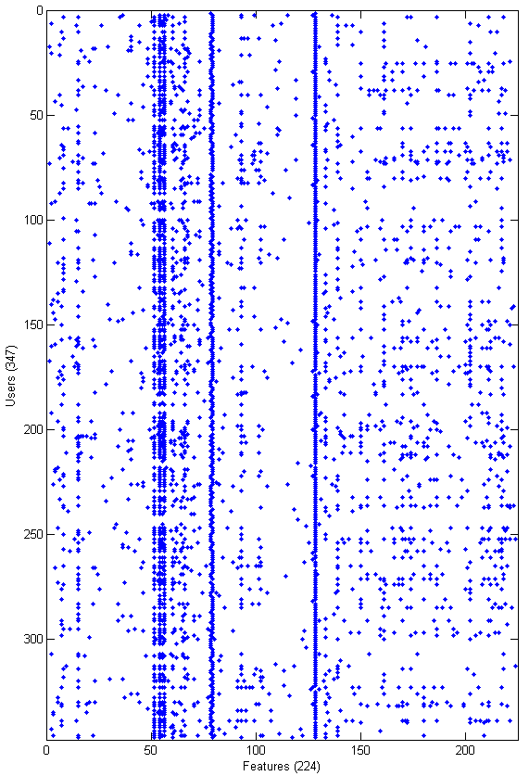
Dataset
347 Facebook users split into friendship circles
224 anonymized binary features grouped into categories
birthday;
education;classes;id;
education;concentration;id;
education;degree;id;
education;school;id; education;type; education;year;id; first_name; gender; hometown;id; languages;id; last_name; locale; location;id; work;employer;id; work;end_date; work;location;id; work;start_date;
[1] http://snap.stanford.edu/data/egonets-Facebook.html

Slide 3
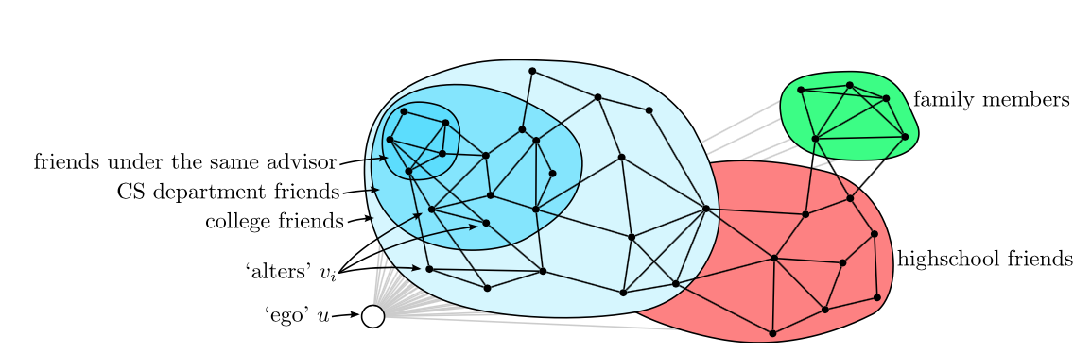
Objective
Unsupervised clustering based on feature data alone
Image from:
Jure Leskovec and Julian J. Mcauley. Learning to Discover Social Circles in Ego Networks. .p. 548--556 2012 http://books.nips.cc/papers/files/nips25/NIPS2012_0272.pdf

Slide 4
Approaches
K-Means
DBSCAN
SOM
Spectral Clustering

Slide 5
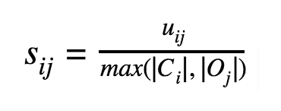

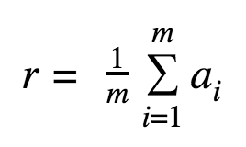
Accuracy Measure
NOTE:
C_{i} is the i’th cluster we identified and O_{j} is an actual user specified cluster

Slide 6
Selected Results

Slide 7
Conclusions

